Slide 1


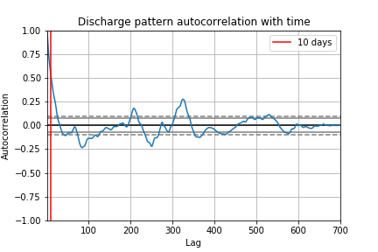
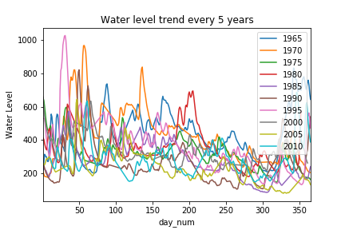
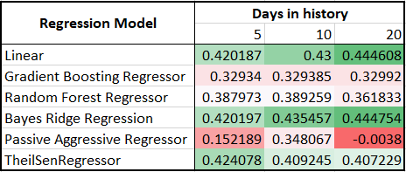
Rhine Water Level Prediction using Historic Data
Team 5: Akanksh Shetty, Lakshmi Maddirala, Kanishk Mair, Xinzhe Qi, Yuxin Yao
Motivation and Objective
Time Series Analysis of data
Machine Learning model
Uncertainty over the water level may causes
Raw material shortages
Difficulty in distribution of finished goods
Covestro is not able to use all the water available to maximum extent.
Improved predictions will improve Business Value by:
Planned production of finished goods.
Avoiding inventory buildup and customer dissatisfaction.
Efficient use and less dependency on external sources for water.
The features and the labels in the dataset are related in time-based manner. So the features for the days to be predicted were modeled with ARIMA.
Based on auto-correlation graphs, 10 days of previous data was used to model the feature set. They are:
The following model architecture with 5 days of water level history was modeled.
For the above model with hyperparameters optimized, an R² of 0.4219 was achieved.
Water level (day-5 to day-1)
Features (day)
LSTM layer
Dense layered Neural Network
Water level (day)
Dataset
The dataset comprised of two files:
Weather recorded at nearby weather stations
Discharge and water level from the stations
- The models were made for the
2 stations rather than a general
model for any station.
- The nodes at Duesseldorf (50)
and Cologne (60) get
discharge from other nodes.
- Accordingly, the discharge from
them were accounted as Incoming.
River Data
Discharge
Incoming water
Weather Data
Rain level
Snow level
Conclusions
Regression models
Improving prediction Accuracy
From all the results, it can be observed that the model accuracy saturates to around 0.4. Thus there is a need for improved feature data.
The classification features could not be modeled using ARIMA and were omitted. Accurate modeling of these can boost the predictions.
The modeled trained only used features for the output day. A more complex model containing previous day data of features might improve performance.
Direct use
There are multiple weather predicting tools which can be used to get feature data for prediction days.
Incorporating this instead of the filled values will improve the prediction accuracy.
The data was tested on the following regression models. Water level for previous days and features for the prediction day was used. Hyperparameters were chosen based on the number of features.
The best algorithm was Bayes Ridge Regressor, which was able to reach maximum R² of 0.445.
Conclusion
70
60
45
50

